Slide 1

Shandong Hitec Intelligent Technology Co., Ltd
Intelligent vision inspection technology service provider
HITEC

Slide 2


01
Company Profile
01
02
03
Company Description
Intellectual Property Rights
Corporate Culture
ABOUT HDITEC
INTELLECTUAL PROPERTY
CORPORATE CULTURE

Slide 3


Company Description
About US
A service provider of intelligent vision inspection technology with excellent competitiveness
Shandong Hitec Intelligent Technology Co., Ltd. is a high-tech enterprise focusing on intelligent machine vision and industrial intelligent automation equipment. The products are widely used in the field of meta-universe, electronics, semiconductor, new energy, automobile, medicine and so on.
Over 13%
More than 50 percent
R&D investment for 3 consecutive years
A team of R&D and engineers
Driving the wave of technological innovation
With nearly 100 employees
TOP
major customer service experience
Huawei, Gore, Hisense, Foxconn and others
Copyright © HITEC

Slide 4
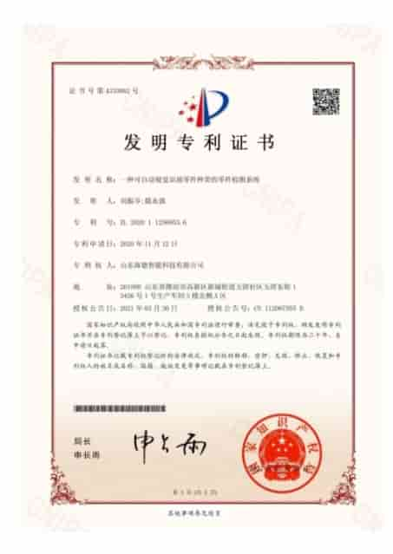





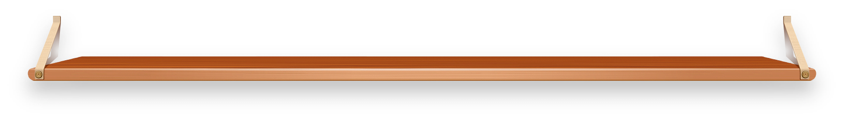






Intellectual Property Rights
We have over 80 independent intellectual property rights in machine vision and related technologie
11
item
26
item
28
item
8
item
6
item
Patents for inventions
utility model patents
software copyrights
Acceptance of patents
Developing corporate standards

Slide 5



Corporate Culture
corporate vision
To become an intelligent vision inspection technology service provider with excellent competitiveness
VISION
MISSION
corporate mission
Centered on user service, continuous scientific and technological innovation
HITEC
corporate values
Responsibility - Responsibility - Mutual trust - Creativity - Inclusion
VALUES

Slide 6
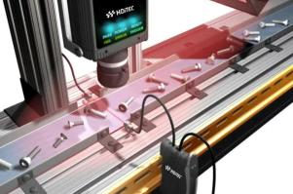
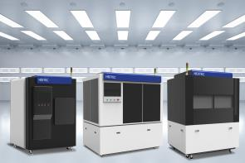
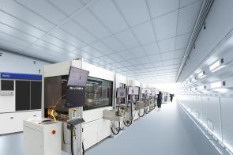

02
product services and solutions
01 Intelligent Vision Systems
02 Intelligent Visual Inspection Equipment
03 Industrial Intelligent Automation Equipment

Slide 7

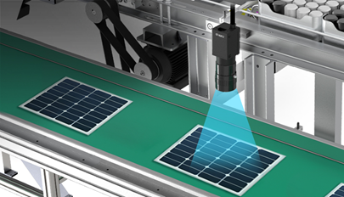
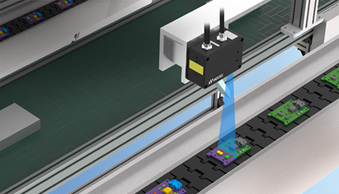
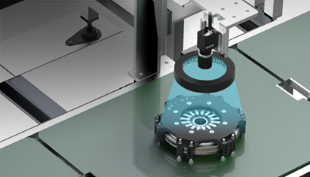
INTELLIGENT VISION SYSTEM
Intelligent Vision Systems
AI Intelligent Vision Inspection | 3D Vision Inspection | 2D Vision Inspection
AI intelligent visual inspection
3D visual inspection
2D visual inspection
It can realize appearance defect detection, classification recognition and OCR recognition in many scenarios, which makes the detection easier and more stable.
It can realize the needs of production scenarios such as product height inspection, fracture difference and flatness measurement.
AOI inspection, dimensional measurement, positioning guidance, OCR recognition and other functions can be realized in a variety of scenarios, and can be customized according to the needs of development.
/37
Copyright © HITEC

Slide 8
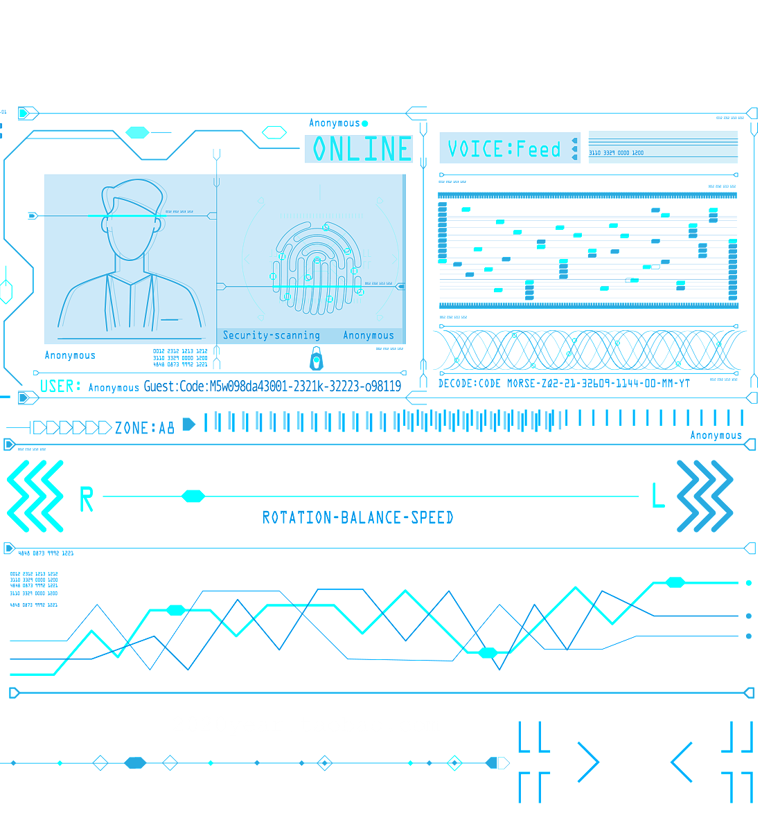
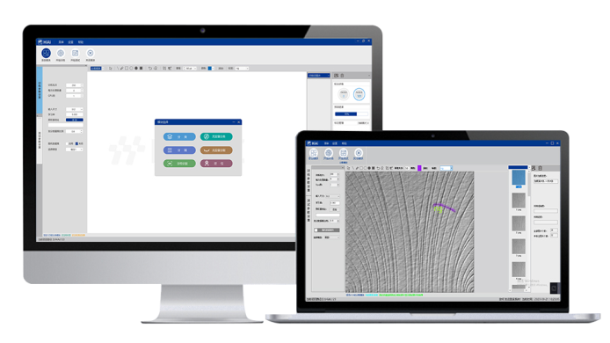







AI intelligent visual inspection
HiAi
Self-developed AI Artificial Intelligence Visual Detection Algorithm
With the rapid development of AI artificial intelligence technology, AI intelligent detection technology has gradually begun to be applied in the industrial field, has been widely used in 3C electronics, medicine, automotive, new energy and other industries, which combined with the traditional algorithms can be realized on the appearance of defective products for high-precision detection. Self-developed deep learning platform algorithms, software, operation and deployment of simple, easy to use, reliable application in the production line production inspection.
powerful AI recognition
algorithms
greater stability and reliability
HiAi
Simple and easy to use
Wide range of application scenarios
Detecting details with greater finesse and precision, the
complex imaging contexts
greater immunity to interference
Breaking the domestic and foreign
monopoly position
products with the same function
Nearly 50 percent cost reduction
Leading the industry
Self-innovation
/37
Copyright © HITEC

Slide 9
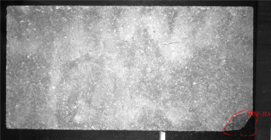
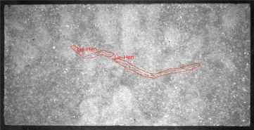
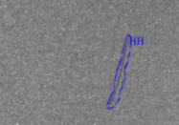
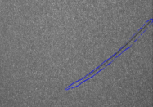
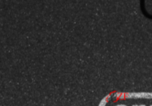
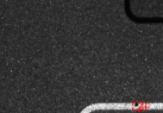




AI Intelligent Visual Inspection
3C Industry - Backplane Appearance Inspection
New Material Industry - Brick Defect Detection
Pain point: There are scratches, bad laser engraving and other defects in the assembly process of backplane production, and the traditional recognition algorithms are unable to detect them stably due to the interference of complex imaging background.
Advantage: It can realize the inspection of production assembly quality and improve the quality of finished products.
Pain point: brick production process there are cracks, missing corners, broken and other traps, conventional vision can not achieve stable detection.
Advantage: It can realize the detection of defective appearance, and effectively avoid the outflow of defective products.
Scratches
Scratches
Bad laser engraving
Bad laser engraving
defect map
defect map
product features
product features
1. Compatible with a wide range of product types, the
2. Data visualization and intelligent processing
3. Simultaneous six-side inspection, high efficiency
4. Unique AI recognition algorithm has higher stability and better recognition effect than traditional algorithms.
1. Compatible with a wide range of color product types, the
2. Multi-camera synchronized detection, high precision and speed
3. Powerful AI recognition algorithm has a better detection effect on backplane defects and higher stability.
Technical parameters
Technical parameters
Critical defects, zero missed
Combined leakage rate less than 0.5%
False detection rate <1%
CT < 0.3 sec. per piece
Defect detection accuracy <0.02mm
Critical defects, zero missed
Combined leakage rate less than 0.5%
False detection rate <1%
80% increase in productivity
Savings in manpower of 2 persons
/37
Copyright © HDITEC

Slide 10
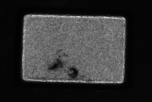
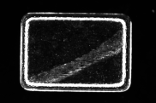
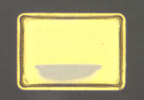
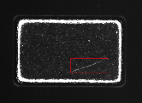
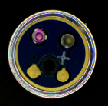
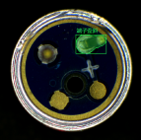
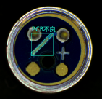
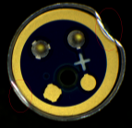
AI Intelligent Visual Inspection
Semiconductor Industry - Metal Casing Defect Detection
Semiconductor Industry - Sensor Appearance Inspection
Status: metal shell in the production process, the surface of the scratches, white spots, dirty, leakage of plating, spots, yellow marks and other problems, affecting product quality.
Pain point:Defective products that do not meet the requirements need to be detected and solved in time through strict quality control and defect analysis.
Advantage: It can realize the classification and detection of defects on metal casing, which greatly improves the stability and efficiency of detection.
Status: Sensors in the production process, there will be skewed terminals, less terminals, PCB bad, bad sealing and other problems
Pain point:Traditional recognition algorithms are unable to stabilize detection due to interference from complex imaging backgrounds.
Advantage: It can realize the inspection of sensor production quality, and the inspection performance is stable.
Dirty
White spots
Leak plating
Scratches
Fewer terminals
Skewed terminals
Bad PCB
Poor sealing of edges
product features
product features
1. Unique AI recognition algorithm is more stable compared to traditional algorithms.
2.AI model is compatible with multiple types of defect recognition such as scratches and dirt.
3. Turntable loading, motion photo detection, higher efficiency.
4. Defective products can be output by defect type and classification level.
Automatic loading and unloading
Data is uploaded to MES in real time
Compatible with a wide range of product types, the
Multi-camera, multi-station inspection
5. Unique AI recognition algorithm is more stable than traditional algorithms.
Technical parameters
Technical parameters
Critical defects, zero missed
Combined leakage rate of less than 1%
False detection rate <3%
CT < 0.3 sec. per piece
Critical defects, zero missed
Combined leakage rate less than 0.5%
False detection rate <2%
CT < 0.3 sec. per piece
productivity of 10,000+/hr
/37
Copyright © HITEC

Slide 11





3D Visual Inspection
3D vision inspection system can realize three-dimensional stereo imaging, by obtaining the XYZ coordinate information of the object to be measured, obtaining its height, volume, cross-section area and other information, solving the application needs of the product to be measured in the direction of height, can realize the product height measurement, flatness measurement, segmentation measurement, size measurement, 3D guidance and other functions, which are widely used in the automotive, electronics, lithium-ion battery, medical and other industries.
Efficient
High precision
Highly resistant to interference
High stability
/37
Copyright © HITEC

Slide 12
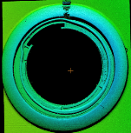

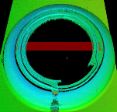

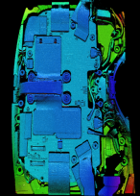
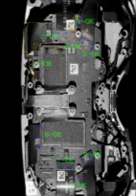

3D Visual Inspection
3C Industry - Watch Lower Case Glue Path Inspection
3C Industry-VR Glasses FPC Connector Installation Quality Inspection
Pain point: In the assembly process of smartwatch, the state of glue application (leakage, broken glue, glue bias, glue height over the limit, etc.) will affect the assembly quality of the product, and the traditional algorithms can't differentiate the color of the glue and the product when the color of the glue and the product are close to each other, so it is impossible to achieve stable detection.
Advantage: It can realize the extraction of glue path by height, width and volume information, which greatly improves the stability of detection.
Pain points: VR glasses in the production and assembly process, there are a number of connectors and connectors need to be installed, manual assembly process is not installed in place, affecting the overall performance of the product; traditional 2D algorithms can not recognize the height of the connector information.
Advantage: Height information can be used to measure the mounting height of the connector, which improves the stability and efficiency of the inspection.
3D rendering
Processing charts
3D rendering
Processing charts
product features
product features
3D renderin
2D processing map
1. Strong anti-interference ability, not affected by the ambient light at the site
2. It can solve the problem of low contrast imaging of vinyl and black shell
3. The rotary scanning method allows for better imaging of the adhesive path
1. Strong anti-interference ability, not affected by the ambient light at the site
2. Unique scanning angle effectively solves the problem of high reflection on the connector surface
3.NG position automatic pressing solution, without manual intervention
4. Connector mounting height can be detected.
Technical parameters
Technical parameters
Visual inspection accuracy of 4~6um
50% increase in efficiency
Detection CT < 2 sec. for single product
100% detection rate
Overkill rate <3%
Visual inspection accuracy of 4~6um
30% increase in efficiency
Detection CT <1.5 sec. for single product
100% detection rate
Overkill rate <1%
Alignment accuracy within 0.01mm
/37
Copyright © HITEC

Slide 13
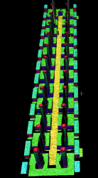

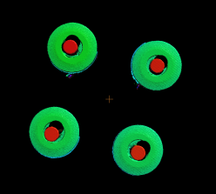
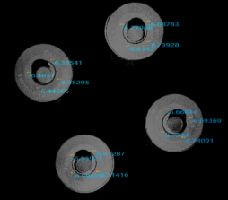

3D Visual Inspection
Automotive Industry-automotive Connector Pin Inspection
Automotive Industry - Engine Locking Clip Inspection
Pain point: automotive connectors in the production process, there are missing pins, pin skew, pin defects and other bad problems, the traditional 2D vision can not be realized pin height detection.
Advantage: Efficient and reliable connector pin detection with height information.
Pain point: The engine locking clamps are not assembled in place, leakage and mixing in the production assembly process, which cannot be stably detected by the traditional 2D vision.
Advantage: It is possible to realize the detection of engine locking clamps by height information, and quickly detect defective products.
3D rendering
2D processing map
3D rendering
Processing charts
product features
product features
1. Compatible with both straight and curved needle detection
2. Fast change of production, one key switch, compatible with 24 kinds of product testing
3. Unique scanning method can avoid noise interference, excellent imaging effect on pins
4.3D vision compared with the traditional 2D vision detection range is wider, to meet the XYZ three-dimensional detection.
1. 6 groups of locking clamp detection can be realized at the same time
2. Real-time uploading of inspection data to MES
3. Real-time process monitoring, data visualization and processing
4. Stable detection of bad locking clip installation through high feature extraction
Technical parameters
Technical parameters
Visual inspection accuracy of 4~6um
60% increase in efficiency
Single product detection CT <1.2 sec
100% detection rate
Overkill rate <1%
Alignment accuracy within 0.01mm
Visual inspection accuracy of 4~6um
40% increase in efficiency
100% detection rate
/37
Copyright © HDITEC

Slide 14
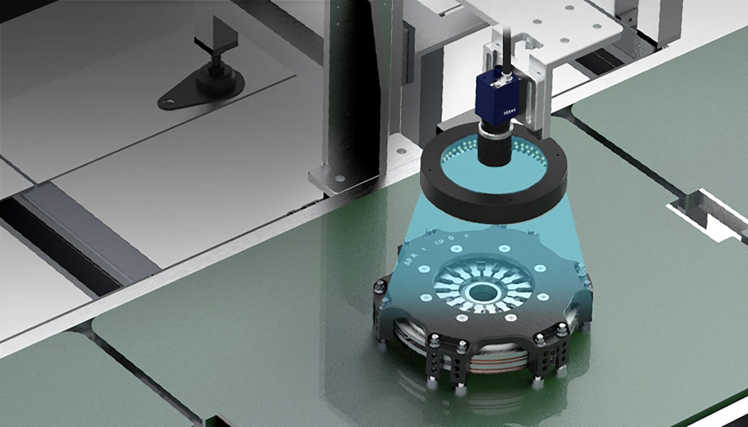

2D Visual Inspection
At present, the degree of automation of industrial production is getting higher and higher, more and more manual work is replaced by machine vision equipment. Traditional manual inspection is mainly through the human eye to identify, rely on experience to judge the product is good or bad, which leads to the inspection of the product quality is not high. In addition, manual inspection is difficult to meet the inspection requirements of high-speed production lines, low production efficiency and high labor costs. Machine vision inspection is the use of machine vision equipment, to achieve fully automated, efficient, durable, stable detection, can greatly meet the production needs.
2D vision-based inspection technology application scenarios include defect detection, guide positioning, size measurement, OCR character recognition, etc., which are widely used in industries such as electronics, automotive, medical, food and so on. With the continuous development and progress of technology, the application of machine vision inspection technology will be more and more extensive, bringing more convenience and benefits for industrial production.
Increased efficiency and reduced labor
Highly accurate and reliable
Flexible, intelligent, unmanned
/55
Copyright © HITEC

Slide 15
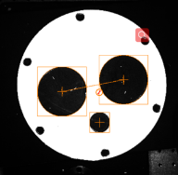
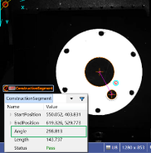
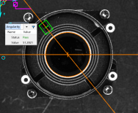
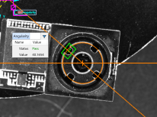
2D Visual Inspection
Guided-Camera-Guided Grab
Guide-Flange Angle Correction
Pain point: camera in the automated production and assembly process, the position of the incoming material can not guarantee the consistency of blind assembly can not meet the production requirements.
Advantage: It can realize the precise positioning of camera angle and position, guide the robot to complete the camera assembly, and improve the precision and efficiency of automated production.
Status: flange in the process of lathe processing, the need to ensure that the incoming material position, angle consistency
Pain point: the problem of incoming materials will lead to large deviations in the processing accuracy of flanges, and the scrap rate is high.
Advantage: It can realize to correct the angle of the flange, which greatly improves the stability and efficiency of production.
Processing charts
Processing charts
Processing charts
Processing charts
product features
1. Compatible with a wide range of models, the
2. Unique lighting program to solve the problem of interference caused by the difference between light and dark on the surface of the product
3. Multi-purpose machine, with the function of guided feeding and automatic plating
4. Enabling robots to grasp more accurately.
product features
1. Automatic loading and unloading
2. Compatible with 23 models at the same time, the
3. Rapid change of production
4. Solve the problem of inconsistency in the position and angle of incoming materials to reduce the scrap rate
Technical parameters
Technical parameters
Guidance accuracy ±0.05mm
100% recognition rate
<0.5 sec. per CT
1 unit saves 6 manpower
40% increase in detection efficiency
Deskewing accuracy ±0.5°
30% increase in efficiency
0% obsolescence rate
Single product detection CT <0.5 sec
100% recognition rate
/37
Copyright © HITEC

Slide 16
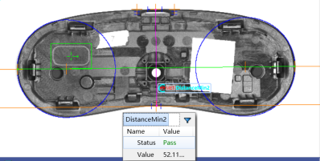
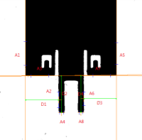
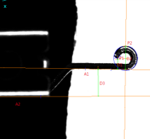
2D Visual Inspection
Measurement - VR Glasses Housing Size Measurement
Measurement - Connector Size Measurement
Pain point: VR glasses shell incoming material size can not guarantee the consistency, resulting in the production of assembly process there is a bad fastening, resulting in product scrap.
Advantage: It can realize VR glasses shell size measurement, and intercept and control the incoming size unqualified products.
Pain point: connectors in the production process to ensure that the size of the tolerance range, manual measurement of low efficiency, poor accuracy, and can not meet the needs of mass production.
Advantage: It can realize the measurement of the size of the connector, and reject the unqualified products of the incoming material size.
Processing charts
Processing charts
Processing charts
product features
product features
1. Stand-alone equipment
2. Simple and flexible operation
3. Ensure the consistency of incoming materials and reduce the product scrap rate.
1. Stand-alone equipment
2. Simple and flexible operation
3. Dual camera synchronized measurement
4. High efficiency, precision and speed
Technical parameters
Technical parameters
Visual Accuracy ±0.05mm
100% recognition rate
<0.5 sec. per CT
30% increase in detection efficiency
Visual Accuracy ±0.01mm
100% recognition rate
CT < 0.3 sec. per piece
60% increase in detection efficiency
/37
Copyright © HITEC

Slide 17
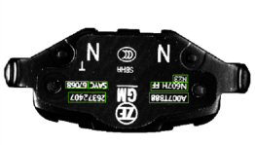
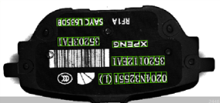
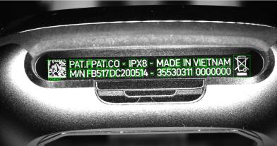
2D Visual Inspection
OCR Recognition - Brake Pad Character Recognition
OCR Recognition - Charging Case Laser Character Recognition
Current situation:Characters on the surface of brake pads need to be recognized for data traceability during the production of brake pads.
Advantage: It can effectively recognize different positions and types of characters
Status:Charging boxes need to obtain laser engraved character information for product traceability and data binding during the packaging process.
Advantage: It can recognize character information through image recognition, realize rapid comparison of information, data upload, etc. It can realize fully automated digital production process, which greatly improves the production efficiency.
Processing charts
Processing charts
Processing charts
product features
product features
1. Compatible with a wide range of colors, the
2. Unique lighting program to solve the problem of interference caused by the difference between light and dark on the surface of the product
3. Data binding and MES uploading
1. Compatible with a wide range of product types, the
2. Data visualization and intelligent processing
3. Higher efficiency of dual-channel
Technical parameters
Technical parameters
100% recognition rate
Single product detection CT <0.3 sec
60% increase in productivity
Saving of manpower by 2 to 4 persons
100% recognition rate
Single product detection CT <0.5 sec
60% increase in productivity
Saving manpower of 3 to 4 persons
/37
Copyright © HITEC

Slide 18
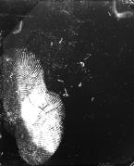
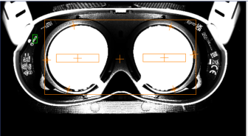
2D Visual Inspection
AOI Inspection-Foreign Object Detection For LCD Screen
Lens Protection Film With or WithoutTesting
Current situation: VR glasses LCD screen in the assembly process needs to ensure a very high degree of cleanliness, the screen surface of the foreign body, fingerprints, etc. have a greater impact on the use of the product.
Advantage: It can realize the detection of foreign objects on the surface of the display, which greatly improves the stability and efficiency of production.
Status: VR glasses in the production flow process, in order to avoid causing damage to the lens, need to be attached to the protective film, the operator in the process of operation there is a leakage of the paste problem.
Pain point: Leakage of the protective film will cause damage to the lens in the flow process, resulting in product scrap.
Advantage: It can realize the lens protection film with or without checking, play the role of error release, greatly improving the stability and efficiency of production.
Processing charts
Processing charts
product features
product features
1. Automatic loading and unloading
2.Unique lighting program to solve the problem of high reflective screen.
3. Rapid production change, high detection efficiency, high detection rate, and
1. Automatic loading and unloading
2. One-click operation and simple deployment
3. Data visualization, real-time upload MES
4. High recognition rate, greatly improve production yield, reduce product scrap rate
Technical parameters
Technical parameters
Visual Accuracy ±0.002mm
60% increase in efficiency
0% obsolescence rate
1 unit saves 6 manpower
100% detection rate
40% increase in efficiency
0% obsolescence rate
Single product detection CT <0.5 sec
0 misses
/37
Copyright © HITEC

Slide 19



INTELLIGENT VISUAL INSPECTION EQUIPMENT
Intelligent visual inspection equipment that
Electronics | New Energy | Automotive
Electronics
New Energy
Vehicles
Consumer electronics, display panels
photovoltaic, lithium-ion, wind power
Automotive electronics, automotive parts and components
/37
Copyright © HITEC

Slide 20


Electronics
Electronic products
Display panel
Consumer Electronics
Long-term service in the electronics industry for more than 10 years, through the mature vision inspection technology to assist customers in technological innovation, improve manufacturing capacity, reduce production costs, and continue to provide customers with perfect, innovative vision technology solutions to meet the needs of the production line production, help customers continue to automation, intelligence, unmanned transformation and upgrading.
/37
Copyright © HITEC

Slide 21
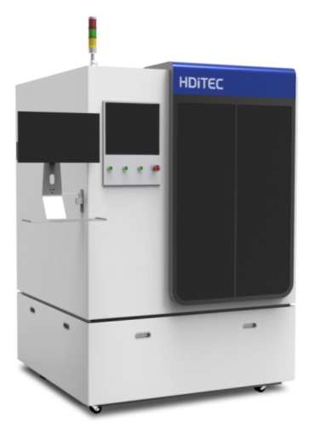
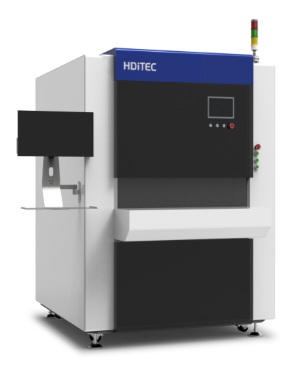
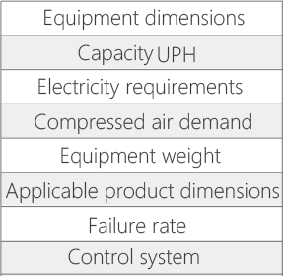
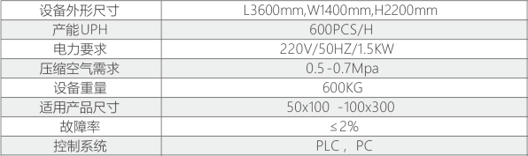
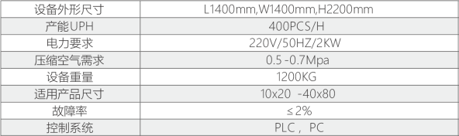
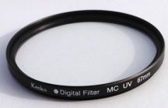




Electronics
Consumer Electronics-Backlight Module Visual Inspection Equipment
Display panel-LCD glass sheet sorting
Product Description
Utilizing advanced machine vision technology, we automatically detect, classify and locate all kinds of surface defects generated during the production process of backlight modules, providing customers with highly reliable and fast surface defect inspection solutions.
Product Description
Using AI deep learning classifier to classify defects and interfering items, it has high classification accuracy for cracks, chipped edges, burrs, breaks, marks, etc., and has the advantages of high inspection accuracy and speed.
product features
Wide compatibility One-click production change Fast product introduction
product features
Intelligent testing, autonomous learning, low error rate
Product Advantage
1. Convenient switching of production, manual one-key switching
2. Easy introduction of new products without specialized knowledge of machine vision
Product Advantage
1.AI deep learning, intelligent learning judgment, high accuracy rate
2. Disc detection, fast speed, UPH up to 10000/H
Equipment parameters
Equipment parameters
Application
Application
/37
Copyright © HITEC

Slide 22









Electronics
Consumer Electronics-PCB Automatic Code Reading Equipment
Consumer Electronics - Headphone Tail Plug Angle Inspection Equipment
Product Description
Product Description
Automatically recognizes the QR code on the surface of PCB and converts it into the corresponding barcode according to the set rules
Using a vision system to take pictures, we calculate the angle at which the tail plug of the headphone is lifted, and determine whether it is defective or not according to the set criteria.
product features
High compatibility Automatic measurement calculation High detection accuracy
product features
High compatibility High conversion rate Low error rate
Product Advantage
1. The field of view can cover up to 600*600mm
2. Minimum reading size up to 10*10mm
Product Advantage
1. Dual-channel detection, UPH up to 600/H
2. Convenient changeover, 10 minutes to complete the changeover, without manual adjustment
Equipment parameters
Equipment parameters
Application
Application
/37
Copyright © HITEC

Slide 23

New Energy
New energy industry
Photovoltaics
Lithium
Wind power
Combined with the new energy industry for many years of vision system development experience, for special materials, equipment, production speed, production of very low error tolerance rate of production needs can be realized quickly replicate the experience, shorten the project landing cycle; for visual inspection applications with high demand for incoming material positioning, dimensional measurement, welded appearance inspection and other technology is more mature, and can be quickly landed on the application.
/37
Copyright © HITEC

Slide 24









New Energy
Photovoltaic-Metal Plate Inspection Machine
Photovoltaic-Photovoltaic Wafer Measuring Equipment
Product Description
This equipment through the production of a large number of visual control specimens, can realize the thickness of the wafer, line marks, hidden cracks, holes, dirt, chipping, size and other items of the simultaneous detection of the detection of fast detection speed, high precision, indicators far more than similar equipment; the use of their own development of the AOI inspection platform to greatly enhance the detection rate of defects, and at the same time the platform is open to the customer free of charge to use, you can choose to increase the new wafer inspection control specimens, compatible with the upgrading of the new product inspection. Compatible with new product testing upgrade.
Product Description
This equipment is designed for card products inspection equipment, cards in the production process may appear printing defects, size overruns, punching position offset and other issues. These situations cause manual detection is difficult, heavy task, it is difficult to achieve the effect of comprehensive detection, so the use of computer vision technology to replace the current manual detection method is to realize the inevitable trend of high-quality intellectual manufacturing.
product features
product features
Unattended High detection accuracy Fast detection speed
Fast detection speed High detection accuracy Simple and easy-to-operate changeover
Product Advantage
Product Advantage
1. Detection speed, high precision, to solve the problem of personnel fatigue
2. Silo automatic feeding, low production cost
1. Multi-threaded processing, fast detection speed, single product size detection within 1S
2. High precision, resolution up to 0.02mm
Equipment parameters
Equipment parameters
Application
Application
/37
Copyright © HITEC

Slide 25









New Energy
Wind Power-small Metal Parts Inspection Platform
Wind power-fan blade 3D scanning dimensional inspection
Product Description
It is mainly used for detecting small and medium-sized parts such as discs, gear rings, gears, oil bearings, piston pins, ball bearings, etc. It can detect the chipping of the upper and lower end surfaces of the workpieces, end face injuries, misalignment, cracks and other appearance defects.
Product Description
By using high-precision photographic 3D scanning to obtain the 3D data of the fan blade impeller; one-button automated scanning, easy and fast to obtain the 3D structure of the fan blade.
product features
Fast detection speed High detection accuracy Convenient and quick changeover of production
product features
Fast detection speed High detection accuracy Large detection field of view
Product Advantage
1. Product vibration plate loading, UPH up to 6000/H
2. Detection accuracy up to 0.02mm
Product Advantage
1. The products come from the assembly line, and it is convenient and quick to change the production
2. The detection field of view can be up to 300*200mm
3. Detecting visual accuracy up to 0.02mm
Equipment parameters
Equipment parameters
Application
Application
/37
Copyright © HITEC

Slide 26


Automobiles
Automobile industry
Automotive electronics
Automotive parts and components
Machine vision inspection equipment is widely used in the automotive industry. It can be used to detect the quality, appearance and safety of automobiles. In addition, machine vision inspection equipment can also be used to detect the precision of automobile parts, these precision requirements are very high, if the manual inspection is difficult to guarantee, but the machine vision inspection equipment can be easily achieved.
/37
Copyright © HITEC

Slide 27









Automobiles
Automotive Electronics-PCB Board Original Inspection
Automotive Electronics-Door Shock Absorber Gasket Sorting Machine
Product Description
Product Description
The inspection equipment automatically scans the product through the camera, then captures the image, compares the tested inspection points with the qualified parameters in the database, and determines the presence or absence of the original parts on the product.
Used for gasket size, hole size, curvature, poor plating, indentation scratches, burrs, nicks, chipping, scratches, indentation, paint loss, dents, symmetry, contour, color and other inspections.
product features
product features
Fast detection speed Low miscarriage of justice Adaptable to a wide range of products
Fast detection speed High detection accuracy Easy changeover
Product Advantage
1. Convenient to change production, compatible size 100*100-300*500 PCB board
2. Flexible detection, can be directly connected with the front and rear end equipment
Product Advantage
1. Convenient to change production, the same type of product testing only need to change the feeding channel
2. Fast detection speed, UPH up to 720/H
Equipment parameters
Equipment parameters
Application
Application
/37
Copyright © HITEC

Slide 28








Automobiles
Automotive Parts-Automotive Parts External Dimension Inspection
Automobile Parts-automobile Valve Automatic Inspection Machine
Product Description
Product Description
It is used for detecting the external dimensions of locomotive parts, which has the advantages of low cost, high precision, high efficiency and convenient operation.
This equipment can realize valve precision dimension measurement as well as identification and classification of defects such as chipping, misalignment, end face injury, cracks, etc.
product features
product features
Adapt to a wide range of products High detection accuracy Fast detection speed
Wide range of compatible products Low leakage rate Fast detection speed
Product Advantage
1. Directly connect with the lathe loading and unloading robot, no need for special modification
2. Double telecentric lens, high detection accuracy, resolution up to 0.01mm
Product Advantage
1. Universal loading mechanism, compatible with 8-25 diameter inner valves
2. Product rotation detection, 360-degree defects without leakage detection
Equipment parameters
Equipment parameters
Application
Application
/37
Copyright © HITEC

Slide 29
INDUSTRIAL INTELLIGENT AUTOMATION EQUIPMENT
Industrial Intelligent Automation Equipment
Electronics | New Energy | Automotive
Electronics
New Energy
Display Panel-Panel Lens Attachment Unit
32
Lithium-Ion Battery Appearance Inspection Machine
33
32
33
Display Panel - In-line vision inspection by 4-axis robot
Photovoltaic-Photovoltaic insulation testing module assembly test line
/37
Copyright © HDITEC

Slide 30








Electronics
Display Panel-Panel Lens Attachment Unit
Display Panel - In-line Vision Inspection By 4-axis Robot
Product Description
Product Description
Lens film of sheet-like incoming material can be automatically absorbed, automatically peeled off, automatically torn off, automatically aligned, and perfectly adhered to the panel. Achieve high precision and bubble-free results. This is a compact machine that realizes semi-automatic production for the Lens lamination process.
The products are brought into the machine in the form of workpieces, and after positioning, the robot carries the vision system to measure the fixed point, and then calculates the external dimensions of the products through the algorithm of the system.
product features
product features
High adherence precision Adaptable to a wide range of products Stable effect without air bubbles
High versatility of the equipment Convenient changeover High detection accuracy
Product Advantage
Product Advantage
1. Dual-channel attachment, UPH up to 800/H
2. Dual vision guidance, attachment precision up to 0.02mm
1. Convenient operation, one key to change production
2. Large detection range, high precision. Range up to 500 * 600mm, precision 0.02mm
Equipment parameters
Equipment parameters
Application
Application
/37
Copyright © HDITEC

Slide 31








New Energy
Lithium-Ion Battery Appearance Inspection Machine
Photovoltaic-Photovoltaic Insulation Testing Module Assembly Test Line
Product Description
Recognize the image characteristics of the pole piece through the high brightness industrial camera, analyze and calculate the characteristic information of the defects, and judge whether the product meets the requirements. Store unqualified product images in the industrial computer and save inspection data for historical data query.
product features
High detection accuracy, good repeatability detection effect, convenient change of production, easy product traceability
Product Advantage
Product Description
Realize the photovoltaic insulation inspection module product feeding, scanning code, printing, buckle cover, labeling, comparison, detection, testing and other functions, the whole process of automatic feeding, unattended, and connected to the MES system to achieve product traceability and production management.
1. High degree of automation
2. High detection accuracy
3. Facilitate product traceability
product features
High versatility Low production changeover costs Easy product traceability
Product Advantage
1. Strong versatility, maximum compatible size up to 80*120mm
2. Monitor the whole process of production, find problems and timely feedback and tracking
Equipment parameters
Equipment parameters
Application
Application
/37

Slide 32
Service capacity
Intelligent Inspection Technology Service Provider
The company has a perfect technical team configuration & high quality after-sales service
The algorithm team
Responsible For The Development And Packaging Of Algorithms For Classification, Segmentation, Localization, Character Recognition, Unsupervised Learning,
Standardized full-cycle technical services
Standardized full cycle technical services
The software team
The application team
Providing customization
integrated services
Resident support
Responsible For The Overall Construction Of The Software Framework That
On-site technical support
The automation team
Well-established technical team
Configuration
Rapid and full delivery
Responsible For The Mechanical Design, Electrical Design And Integrated Development Of Equipment Systems
Quality after-sales service
Fast And Comprehensive Delivery
The test team
Responsible For The Performance Testing Of Products That
Free technical advice for life
Lifetime Free Technical Consultation
The optics team
Design, Build, And Test Of Machine Vision Optical Systems
/37
Copyright © HDITEC

Slide 33
Contact Us
Shandong Hitec Intelligent Technology Co., Ltd
www.hditek.com
tina@hditec.com
Weifang
(Headquarters)
86-0536-6100299
No.3755, Gaoxin 1st Road, Gaoxin District, Weifang, Shandong Province, China (Smart Center)
Competitive excellence
Intelligent vision inspection technology service provider
Corporate mission Centered on user service, continuous scientific and technological innovation
/37

Slide 34
THANKS
Shandong hDITEC intelligent technology Co., LTD
Intelligent vision inspection technology service provider

